Slide 1


Grammar, vocabulary, punctuation and the new curriculum

Slide 2
Why do we need to punctuate?

Slide 3
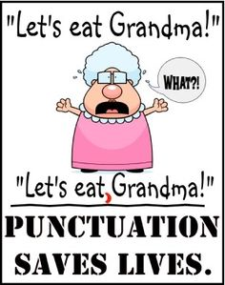

Slide 4
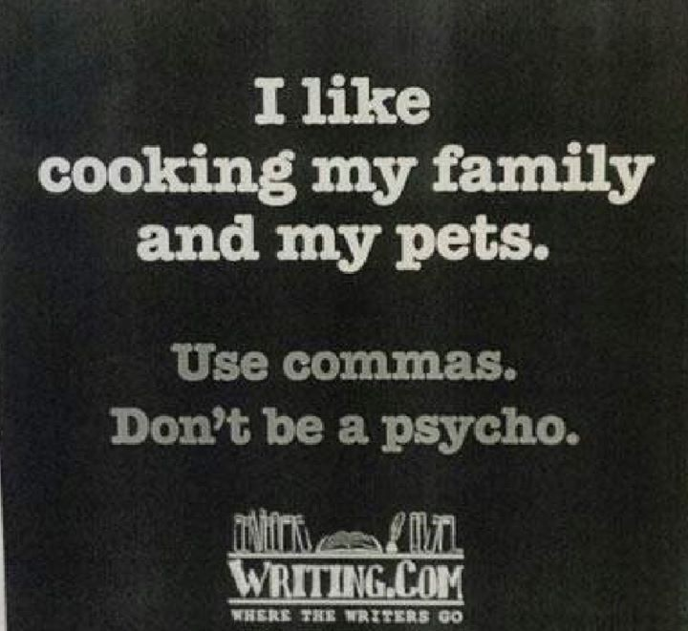

Slide 5


Slide 6
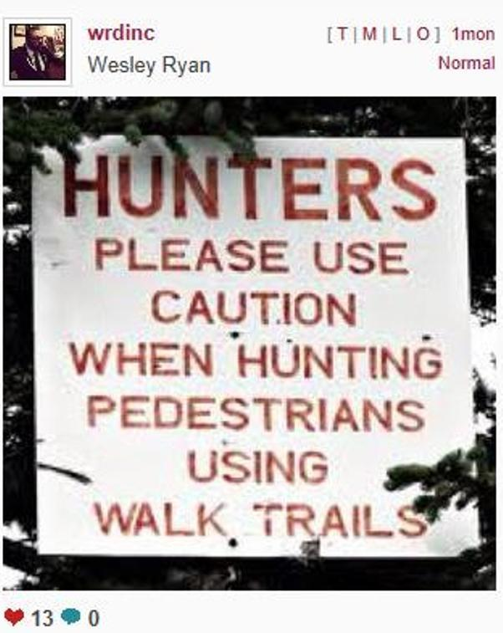

Slide 7
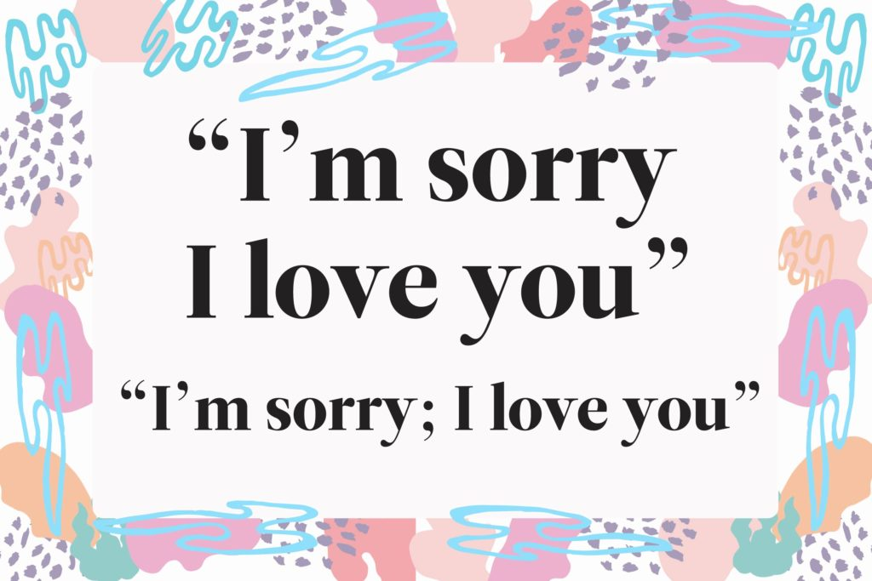

Slide 8
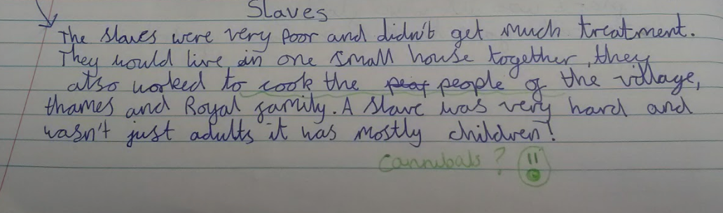

Slide 9
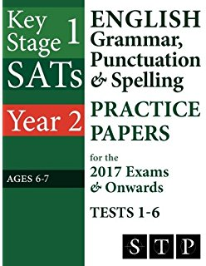
Children are tested on spelling, punctuation and grammar when they are in Years 2 and 6.

Slide 10
Children in Year 2 (aged 6-7) and Year 6 (aged 10 and 11) will still sit tests in reading, maths and spelling, punctuation and grammar. The tests are more demanding than previous years, with more expected of pupils.
Until recently, SATs tests were graded on levels - for example Level 4 was the expected level for children finishing primary school. But these national curriculum levels have been scrapped and instead parents are given their child's raw score (the actual number of marks they get) and whether they have reached the national average and are ‘age related’ or not.
Year 6 SATs are largely marked externally, while Year 2 SATs will still be marked by teachers at the school. Children who do not reach the expected level in their Key Stage 2 tests at the of primary will be expected to re-sit tests when they go on to secondary school.

Slide 11

So what exactly is it your child is expected to learn?

Slide 12
https://www.gov.uk/government/uploads/system/uploads/attachment_data/file/335190/English_Appendix_2_-_Vocabulary_grammar_and_punctuation.pdf

Slide 13
YEAR 1 Content to be taught
The suffixes -s and -es, -ing, -ed, -er and -est
The prefix un- to change the meanings of verbs and adjectives
Learning how to join words to form sentences
Joining words and clauses with the conjunction ‘and’
Sequencing sentences to form short narratives
The use of capital letters, full stops, question and exclamation marks to demarcate sentences
Use capital letters for names and the pronoun ‘I’
Spelling common exception words
Use the terminology letter, capital letter, word, singular, plural, sentence, punctuation, full stop, question mark, exclamation mark

Slide 14
http://www.bbc.co.uk/bitesize/ks1/literacy/making_sentences/play/

Slide 15
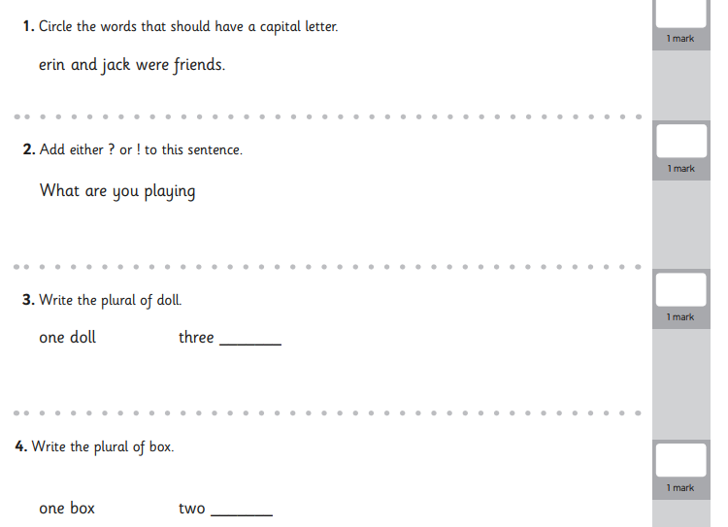

Slide 16
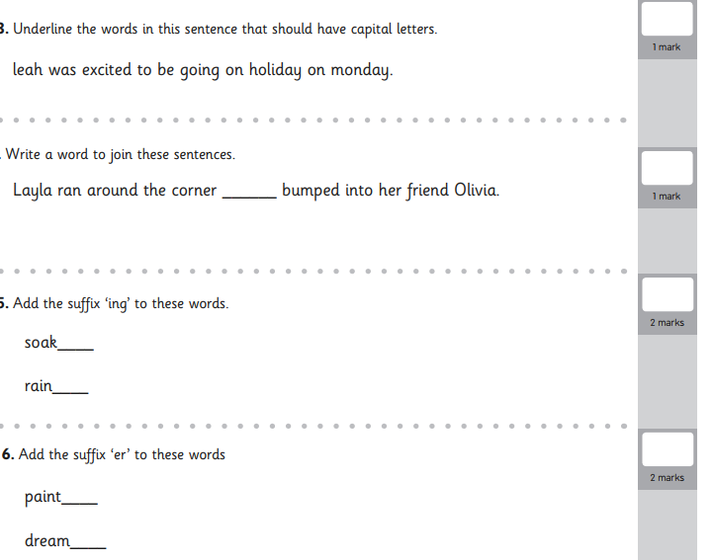

Slide 17
YEAR 2 Content to be taught
Suffixes -ness, -er, -ful, -less, -er, -est, -ly
Compound words eg. football, handbag
Subordinating conjunctions when, if, that
Coordinating conjunctions and, or, but
Expanded noun phrases eg. The blue butterfly.
The correct choice and consistent use of the present and past tense.
The use of the progressive form in past and present tenses eg. She is sunbathing. He was shouting.
Punctuation learnt in year 1 plus commas to separate items in a list.
Apostrophes in contractions eg. couldn’t, and to show singular possession in nouns eg. The boy’s bag.
Terminology noun, noun phrase, compound, suffix, adjective, adverb, verb, tense (past and present), apostrophe, comma.

Slide 18
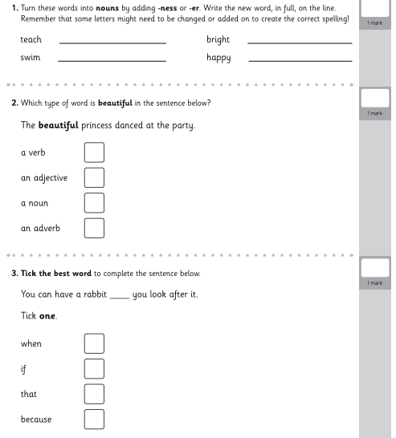

Slide 19
We use lots of games and fun activities to teach SPAG activities
http://www.besize/ks1/literacy/joining_words/play/bc.co.uk/bit
year 2

Slide 20
YEAR 3 Content to be taught
Prefixes anti- , auto- , super-
Use ‘a’ and ‘an’ correctly
Know how words in a word family are related eg. solve, solution, dissolve, insoluble
Express time, place and cause using: Conjunctions: when, before, after, while, so Adverbs: for example, then, next, soon, therefore Prepositions: during, because of
Paragraphs to group related material
The present perfect form of verbs eg. He has gone out to play. Instead of, He went out to play.
Inverted commas to punctuate direct speech
Use the terminology: preposition, conjunction, word family, prefix, clause, subordinate clause, direct speech, consonant, vowel, inverted commas

Slide 21
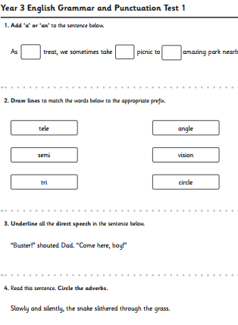

Slide 22
YEAR 4 Content to be taught
Grammatical difference between plural and possessive -s
Standard English forms for verb inflections instead of local spoken forms
Eg. We were at school. Instead of We was at school.
I did my writing. Instead of I done my writing.
Noun phrases expanded by adjectives, nouns, prepositional phrases.
Fronted adverbials.
The appropriate choice of pronoun or noun.
Inverted commas and other punctuation to indicate direct speech.
Apostrophes to mark plural possession.
Use of commas after fronted adverbials.
Terminology: determiner, pronoun, possessive pronoun, adverbial.
Notes:
•Pronouns are used in place of nouns.
e.g. Jack tried to carry Jack’s bag but Jack’s bag was too heavy for Jack.
Jack tried to carry his bag but it was too heavy for him.

Slide 23
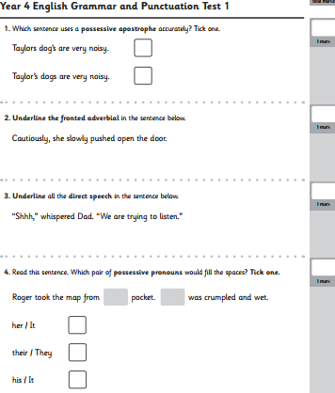

Slide 24
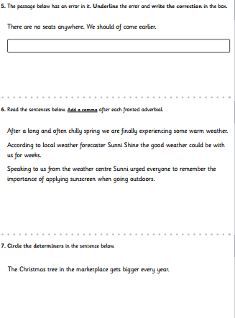

Slide 25
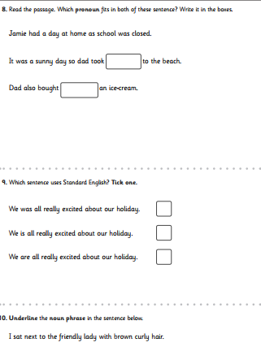

Slide 26
Who thinks they’re up for a punctuation and grammar challenge?
Notes:
Show Who Wants to be a Millionaire quiz.

Slide 27
•Useful and reliable websites
•
•http://learnenglish.britishcouncil.org/en/english-grammar
•
•http://oxforddictionaries.com/words/punctuation
•
•https://oxforddictionaries.com/words/grammar
•
•https://oxforddictionaries.com/words/spelling

Slide 28


